Slide 1
CSC 8711
Prof: Dr. Raj Sunderraman
By:
Sara Karamati
Sadhna Kumari

Slide 2
Outline
Introduction
InfiniteGraph Overview
Technical Specification
Application Demo
References

Slide 3
Introduction
Our digital ecosystem is expanding
web traffic
social media
financial transactions
email
phone calls
IT logs
IBM estimates that 90% of the data in the world today has been created in the last two years alone.
Leading analyst firm, Gartner, reports global enterprise data assets to grow by an additional 650 percent by the end of 2014.
Buried in this mountain of data is intelligence that can be used to shape strategy, improve business processes and increase profits. Thus, NOSQL systems are being developed.

Slide 4
NOSQL Databases
Key- value Databases
A key-value database is similar to a relational database with rows, but only two columns. The indexing system uses a single string (key) to retrieve the data (value) .
Very fast for direct look –ups
Schema - less, meaning the value could be anything, such as an object or a pointer to data in another data store
Column Family Databases
Column family databases also have rows and columns like a relational database, but storage on disk is organized so that columns of related data are grouped together in the same file. As a result, attributes (columns) can be accessed without having to access all of the other columns in the row.
Results in very fast actions related to attributes, such as calculating average age
Performs poorly in regular OLTP applications where the entire row is required

Slide 5
NOSQL Databases Contd..
Document Databases
Document databases are similar to object databases, but without the need to predefine an object’s attributes (i.e., no schema required).
Provides flexibility to store new types or unanticipated sizes of data/objects during operation
Graph Databases
Graph databases are also similar to object databases, but the objects and relationships between them are all represented as objects with their own respective sets of attributes.
Enables very fast queries when the value of the data is the relationships between people or items
Use Graph Databases to identify a relationship between people/items, even when there are many degrees of separation
Where the relationships represent costs, identify the optimal combination of groups of people/items

Slide 6
Infinite graph overview

Slide 7
History
Started as an internal project in Objectivity focusing on management and analysis of graph data.
It took the high performance distributed data engine from Objectivity/DB and married it to a graph management and analysis platform.
Objectivity/DB Provides Powerful distributed object storage, Flexible class based persistence, Enterprise DB features
But…. Lots of custom coding, Complex deployment, No generic algorithm framework
Distributed Object Database Native core (broad platform support) with C++, Java, C# and Python Bindings

Slide 8
Customers & Partners

Slide 9
Releases
1.0: first iteration and was offered as a public beta.
2.1: first commercial release
3.0: more features were added focused around scaling the graph in a distributed environment.
3.1: On April 29, 2013 - Offers Improved Data Ingestion, Faster Search Results, and Open Use Data Connectors

Slide 10
Targeting Large Graphs
Typical Use Cases
- Social Graph Analysis
- Catching Bad Guys
- Fraud / Financial (more bad guys)
- Data Intensive Science
- Web / Advertising Analytics
Graphs grow quickly
Some analytics require navigation of large sections of the graph

Slide 11
Distributed Graph Databases Must have
Optimized around data relationships
Small focused API (typically not SQL)
Must distribute data and go parallel

Slide 12
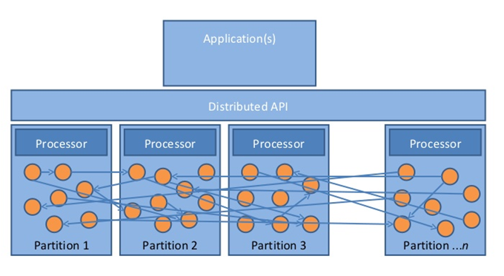
Distributed Graph Partitioning
Graph partitioning is not as simple
Graph operations are rarely partition bound
Repartitioning is expensive
Partitions must co-operate

Slide 13
Distributed Navigation
Graph algorithms naturally branch
Breaking up the process is relatively simple
Orchestrating it is more challenging

Slide 14
Consistency Model
Trading off full consistency for performance
Relax locking, allow stale reads
Gain 100x edge ingest rates
Great for “social graph” applications : These tend to have relaxed consistency requirements
API allows choice per operation

Slide 15
Features
Simple Graph focused API
Automated distribution and deployment
A distributed data tier supports parallel IO
Ability to deal with remote data reads (fast)
High performance distributed persistence (Java Class based)
Distributed navigation processing: Asynchronous navigation
Distributed, multi-source concurrent ingest
Indexing framework
Write modes supporting both strict and eventual consistency

Slide 16
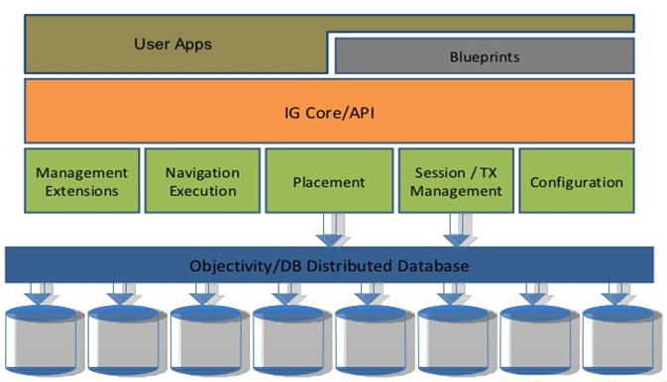
Architecture

Slide 17
Technical Specification

Slide 18
Schema Model
InfiniteGraph saves edges and vertices as persistent data.
The library consists of two classes namely BaseVertex and BaseEdge which are defined as persistent.
All the instances of vertices should inherit from BaseVertex or subclass of BaseVertex. Similarly, edge instances should inherit from BaseEdge.
The instances can be saved in an InfiniteGraph graph database. Instances of a persistent class can act both as standard Java runtime objects and as persistent elements stored in an InfiniteGraph graph database.
At the time of database write, the values of fields are also persistently stored.

Slide 19
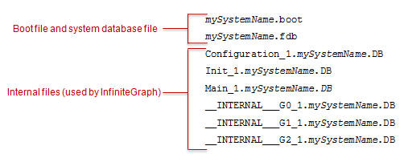
Creating Graph Database
Graph database is created by providing a system name, which is a logical name for the graph.
GraphFactory.create("mySystemName") ;
creates in default working directory
GraphFactory.create("mySystemName", "myPropertyFilePathName") ;
creates in path specified in “.properties” file

Slide 20
Connecting to Graph Database
To connect to Graph, logical name is provided.
GraphFactory.open("mySystemName");
GraphFactory.open("mySystemName", "myPropertyFilePathName");
A graph can be created with one property file, and opened with a different one.
Once connected to a graph, an application can access, update, or instantiate persistent elements inside a read or read/write transaction.

Slide 21
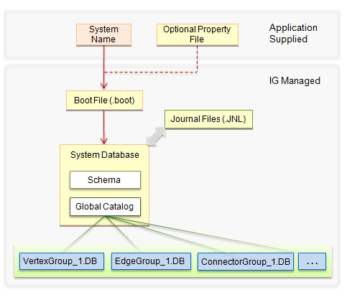
Graph with Persistent Elements
The first time persistent elements are added to the graph, database files are created to store those elements
Vertex instances are placed in VertexGroup_n.systemName.DB
Edge instnaces are placed in EdgeGroup_n.systemName.DB
Internal information related to edges is stored in ConnectorGroup_n.systemName.DB.
Locations of those database files are added to the system database file.
The schema definitions for the elements are also added to the system database file. Moving forward, additional instances of that type have access to the schema.
Each new persistent element that is added to the graph is given a unique identifier and stored in the appropriate database file.
As applications make updates to the graph, journal files are created. These files are used to return the graph to its previously committed state if a transaction is aborted or terminated abnormally.

Slide 22
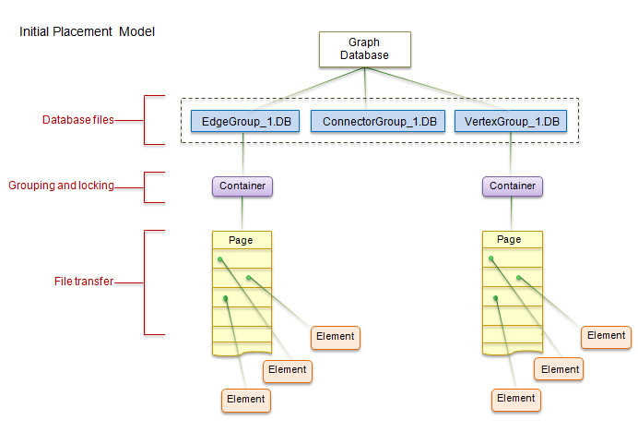
Placement of Persistent Elements

Slide 23
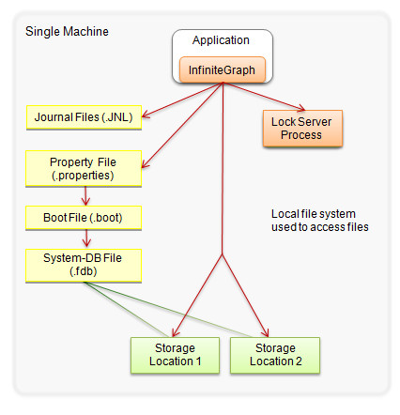
Local Data Access

Slide 24
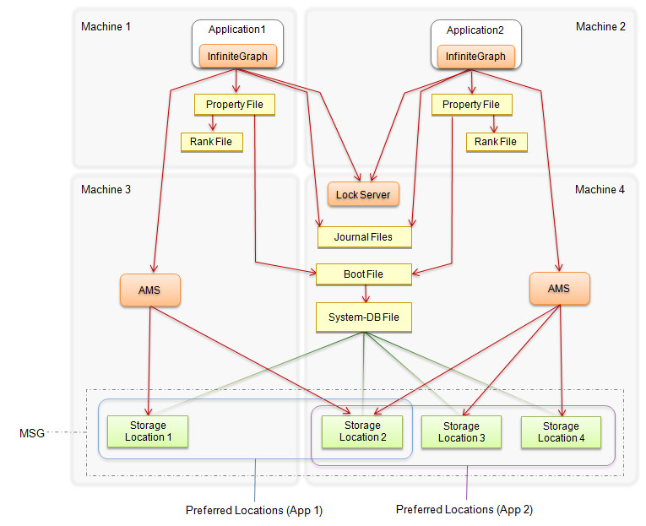
Distributed Data Access
AMS: Advanced Multithreaded Server serves data
Each application has an XML rank file that designates its preferred storage locations.

Slide 25
Data Creation
Creating an Employee vertex that can be used as a Java runtime.
public class Employee extends BaseVertex { // Fields private String name; private String department; private int id; private boolean permanent; ... } Employee emp1 = new Employee("John");
The vertex becomes persistent when it is explicitly added to the graph database.
myGraph.addVertex(emp1);
An edge becomes persistent after it is passed to an addEdge method.

Slide 26
Ingesting Data: Flow
Start a new transaction.
For each from vertex,
check whether or not it already exists in the database.
If no, create the vertex and return a reference to it.
If yes, return a reference to it.
For each to vertex, repeat the above process.
Create the edge, passing in the from and to vertices.
Increment counters, commit the transaction, and repeat the cycle.

Slide 27
Ingesting Data
Standard ingest
easy to set up and use
appropriate when ingesting data in a single thread or process.
use InfiniteGraph APIs such as addVertex and addEdge to ingest data inside a read/write transaction.
The ingested data is immediately consistent and available upon commit of a transaction.
Accelerated ingest
particularly effective when ingesting data with large numbers of edges.
can provide optimal performance when ingesting large amounts of data using multiple threads or multiple processes.
the ingested data has eventual consistency because not all edges are immediately available after a transaction is committed.

Slide 28
Navigation
Get the Member vertex named "Lisa“ as starting point.
Member lisa = (Member)WebGroupSampleDB.getNamedVertex("Lisa");
Create instance of result handler
PrintPathResultsHandler resultPrinter = new PrintPathResultsHandler();
no filtering is performed
Navigator myNavigator = lisa.navigate(null, Guide.SIMPLE_DEPTH_FIRST, Qualifier.FOREVER, Qualifier.ANY, null, resultPrinter)
Default policy chain
qualifies every possible path and result

Slide 29
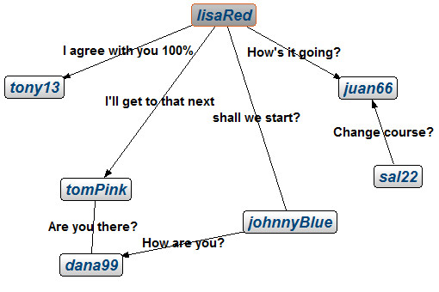
Navigation
myNavigator.start();
... - > Starting an update transaction ... ... - FOUND MATCHING PATH: ... - lisaRed < Sat May 21 08:45:22 PDT 2011 > tomPink ... - FOUND MATCHING PATH: ... - lisaRed < Sat May 21 08:45:22 PDT 2011 > tomPink < Sun May 22 03:45:22 PDT 2011 > dana99 ... - FOUND MATCHING PATH: ... - lisaRed < Sun May 22 07:45:22 PDT 2011 > juan66 ... - FOUND MATCHING PATH: ... - lisaRed < Sun May 22 03:45:22 PDT 2011 > johnnyBlue ... - FOUND MATCHING PATH: ... - lisaRed < Sun May 22 03:45:22 PDT 2011 > johnnyBlue < Sat May 21 10:45:22 PDT 2011 > dana99 ... - FOUND MATCHING PATH: ... - lisaRed < Sun May 22 03:45:22 PDT 2011 > johnnyBlue < Sat May 21 10:45:22 PDT 2011 > dana99 < Sun May 22 03:45:22 PDT 2011 > tomPink ... - FOUND MATCHING PATH: ... - lisaRed < Sat May 21 09:45:22 PDT 2011 > tony13 ... - > Program completed ...

Slide 30
Indexing
import com.infinitegraph.indexing.*;
Class to add Index
IndexManager.addGraphIndex("personGraphIndex", Person.class.getName(), new String[] {"name"}, false);
Identifies Person vertices
Key Field
Method to Add Index
Every Person vertex added to the graph database is automatically included in the index.
You can also create a graph index with multiple key fields. The first key you provide is used as the primary sort key.
IndexManager.addGraphIndex("personGraphIndex", Person.class.getName(), new String[] {"name"}, false);

Slide 31
Query
You can execute a high performance database-wide query with the help of the placement manager and any graph indexes that are available.
Following code creates a query object that identifies Person vertices whose name field value is John.
Assuming there is a graph index on the name field of the Person class, this query will have optimal performance when executed.
Query object can be created if graph database does not have graph indexes, but it doesn’t provide performance gains seen when a corresponding graph index exists.
Query<Person> personQuery = myGraph.createQuery(Person.class.getName(), "name== 'John'");
Query object
Identifies Person vertices
Predicate string

Slide 32
Query
To use the query object, execute it to create an iterator that lets you cycle through any matching elements:
The following code works even though the age field of the Person class is not one of the indexed fields:
The performance of the above query is improved when both name and age are indexed.
Iterator personItr = (Iterator) personQuery.execute(); while (personItr.hasNext()) { Person myPerson = (Person) personItr.next(); System.out.println("Found person named " + myPerson.getName()); }
Query<Person> personQuery = myGraph.createQuery(Person.class.getName(), "name== 'John' && age < 100");
Indexed Field
None Indexed Field

Slide 33
Lock Server
The lock server manages concurrent access to persistent elements by granting or refusing locks to requesting transactions.
3
If an application attempts to write data to a container that is already locked, the second lock is granted only if it is compatible with the existing lock. Two read/write locks cannot be granted on the same container at the same time
1
A transaction requests data from a graph database
Container
Container
Container
2
InfiniteGraph locates the lock server for that graph and requests a lock on the container holding the data.

Slide 34
Lock Server
When such a conflict occurs, InfiniteGraph reacts according to the application's configured LockWaitTime property.
By default, InfiniteGraph fails immediately on such a conflict, issuing an exception. You can change the default behavior to wait for a specified number of seconds or to wait indefinitely.
InfiniteGraph does allow multiple read operations to occur concurrently with a single read/write operation (MROW).
You can change the UseMrowTransactions configuration property to false to disable MROW.

Slide 35
Backup
A backup is a snapshot of a graph database at a particular point in time.
The first time you perform a full backup, you start what is known as a backup set. You can add to the backup set with periodic updates.
InfiniteGraph provides a basic backup capability: Automatically generates the names of all backup files and implicitly manages the backup set.
Alternatively, you can perform a custom backup in which you name the backup set and choose from 10 backup levels for the backup events.
Backup Level | What is Saved
Full | Entire graph database.
Incremental | All modified data since the last full backup.
Subincremental | All modified data since the last incremental backup.
Write the backup files in the target directory

Slide 36
Restore
Whether using basic or custom backups, each backup event on a given backup set represents a potential point of restore.
When you perform a restore operation, InfiniteGraph always restores the entire graph database to ensure its integrity.
To restore from a basic backup, a timestamp is specified as a point of restore.
If no backup corresponds exactly to the specified time, it selects the latest backup that was started prior to the specified time.
InfiniteGraph allows full read and write access to the graph database during the backup. However, during a restore, the graph database is locked until the entire restore is completed.

Slide 37
Application

Slide 38
Friends Network

Slide 39
Graph Data

Slide 40
Defining the Status Vertex
public class Status extends BaseVertex { private String message; public Status(String message) { setMessage(message); } public void setMessage(String message) { markModified(); this.message = message; } public String getMessage() { fetch(); return message; } @Override public String toString() { fetch(); return this.message; } }

Slide 41
Defining the Write Edge
class Write extends BaseEdge { private long timestamp; public Write(Calendar date) { setTimestamp(date.getTimeInMillis()); } public Calendar getTimeStamp() { fetch(); Calendar myCal = Calendar.getInstance(); myCal.setTimeInMillis(timestamp); return myCal; } protected void setTimestamp(long timestamp) { markModified(); this.timestamp = timestamp; } @Override public String toString() { fetch(); Calendar myCal = Calendar.getInstance(); myCal.setTimeInMillis(timestamp); return myCal.getTime().toString(); } }

Slide 42
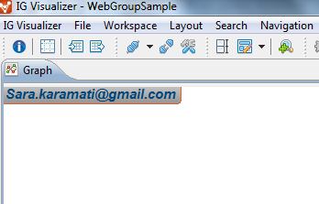
Create Person Node
WebGroupSampleDB = GraphFactory.open(graphDbName, url.getPath()); tx = WebGroupSampleDB.beginTransaction(AccessMode.READ_WRITE); Person user = (Person)WebGroupSampleDB.getNamedVertex(MemberName); if(user==null){ find=false; Person newPerson = new Person(MemberName, password); WebGroupSampleDB.addVertex(newPerson); WebGroupSampleDB.nameVertex(MemberName, newPerson); }

Slide 43
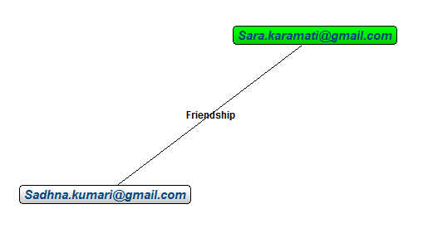
Add a Friend
Friendship newFriend = new Friendship(); Person user = (Person)WebGroupSampleDB.getNamedVertex(userName); Person friend = (Person)WebGroupSampleDB.getNamedVertex(friendName); user.addEdge(newFriend, friend, EdgeKind.BIDIRECTIONAL, (short) 0);

Slide 44
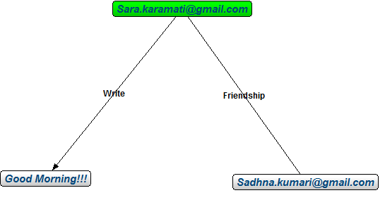
Add a Status Node
Status newStatus = new Status(status); WebGroupSampleDB.addVertex(newStatus); Calendar dateTime = Calendar.getInstance(); Write newPost = new Write(dateTime); Person currentMember = (Person)WebGroupSampleDB.getNamedVertex(memberName); currentMember.addEdge(newPost, newStatus, EdgeKind.OUTGOING, (short) 0);

Slide 45
Navigate Friends network
resultPrinter = new PrintPathResultsHandler(statusId); PolicyChain myPolicies = new PolicyChain(new MaximumPathDepthPolicy(2)); Person user = (Person)WebGroupSampleDB.getNamedVertex(userName); VertexTypes statusVertexType= new VertexTypes(WebGroupSampleDB.getTypeId("com.infinitegraph.samples.webgroup.Status")); Navigator myNavigator = user.navigate(null, Guide.SIMPLE_DEPTH_FIRST, Qualifier.FOREVER, statusVertexType, myPolicies, resultPrinter);

Slide 47
REFERENCES
[1] http://www.objectivity.com/infinitegraph
[2] http://wiki.infinitegraph.com
[3] http://www.nosqldatabases.com/main/tag/ infinitegraph
[4] http://www.objectivity.com/resources/white-papers/

Slide 48
Thank You!

